Slide 1
CRYPTOGRAPHY and NETWORK SECURITY PEC-CS801B, UNIT 1
By
CHINMOY GHOSH
Assntt. Professor,
Deptt. Of CSE, JGEC

Slide 2
What is security?
Security: prevent bad things from happening
Confidential information leaked
Important information damaged
Critical services unavailable
Clients not paying for services
Money stolen
Improper access to physical resources
System used to violate law
Loss of value

Slide 3
A definition of computer security
Computer security: The protection afforded to an automated information system in order to attain the applicable objectives of preserving the integrity, availability and confidentiality of information system resources (includes hardware, software, firmware, information/data, and telecommunications)

Slide 4
Principles of Security (Security Properties)
Confidentiality
Integrity
Availability
Authenticity
Non- repudiation

Slide 5
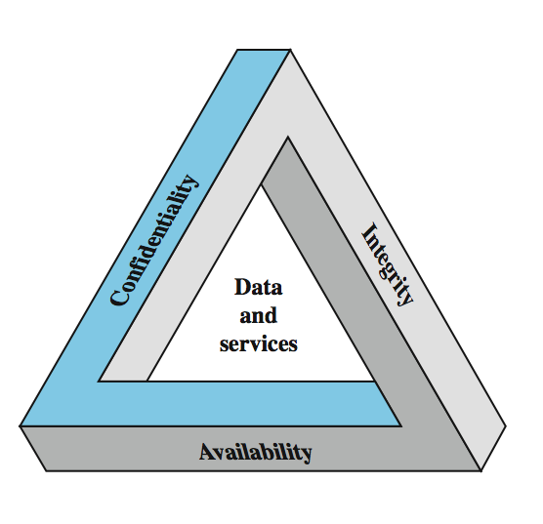
the CIA triad

Slide 6
Confidentiality
It specifies that only the sender and the intended recipients should be able to receive the data.
In information security, confidentiality "is the property, that information is not made available or disclosed to unauthorized individuals, entities, or processes"
Two aspects of confidentiality
Privacy: protection of personal data
e.g., personal medical records, student grade information
Secrecy: protection of data belonging to an organisation
e.g., Formula for a new drug, plans for the company for the next 5 years, Student Records

Slide 7
Integrity
Specifies No improper modification of data
Assures that information and programs are changed only in a specified and authorized manner.
E.g., account balance is updated only by authorized transactions, only you can change your password

Slide 8
Availability
Specifies that resources (i.e information) should be available to authorized parties at all time.
Denial of Service is the prevention of authorised access of resources or the delaying of time-critical operations

Slide 9
Authenticity
Authentication mechanism help establish proof of identities.
the property of being genuine and being able to be verified and trusted; confident in the validity of a transmission, or a message, or its originator.

Slide 10
Non-repudiation
Ability to convince a third party that an event occurred (e.g., sales receipt)
Non-repudiation does not allow the sender of a message to refute the claim of not sending the message.

Slide 11
Attacks
In computer and computer networks an attack is any attempt to destroy, expose, alter, disable, steal or gain unauthorized access to or make unauthorized use of an asset
Attack is a threat that is accrued out
Active or passive; from inside or from outside
Active
Interruption (Availability)
Fabrication (DOS ) (Authentication)
Modification (Integrity)
Replay Attacks
Alterations
Passive
Wiretapping
Interception- release of message content (Confidentiality)

Slide 12
Programs that attack
Virus
A computer virus is a malware program that, when executed, replicates by inserting copies of itself (possibly modified) into othercomputer programs, data files, or the boot sector of the hard drive; when this replication succeeds, the affected areas are then said to be "infected". Viruses often perform some type of harmful activity on infected hosts, such as stealing hard disk space or CPU time, accessing private information, corrupting data, displaying political or humorous messages on the user's screen, spamming their contacts,logging their keystrokes, or even rendering the computer useless. However, not all viruses carry a destructive payload or attempt to hide themselves—the defining characteristic of viruses is that they are self-replicating computer programs which install themselves without user consent.

Slide 13
Worm
Worm
A computer worm is a standalone malware computer program that replicates itself in order to spread to other computers.^{[1]} Often, it uses a computer network to spread itself, relying on security failures on the target computer to access it. Unlike a computer virus, it does not need to attach itself to an existing program.^{[2]} Worms almost always cause at least some harm to the network, even if only by consuming bandwidth, whereas viruses almost always corrupt or modify files on a targeted computer.

Slide 14
Trosan Horse
A Trojan horse, or Trojan, in computing is any malicious computer program which misrepresents itself as useful, routine, or interesting in order to persuade a victim to install it.
Its attemts to reveal confidential information to an attacker.

Slide 15
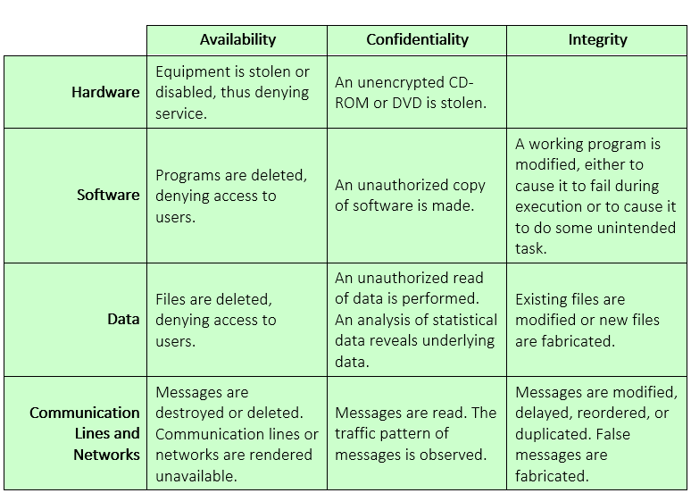
Examples of threats

Slide 16
Eavesdropping
Eavesdropping is secretly listening to the private conversation of others without their consent.
It can be conducted on ordinary telephone systems, emails, instant messaging or other Internet services. Since eavesdropping activities do not affect the normal operation of network transmission, both the sender and the recipient can hardly notice that the data has been stolen, intercepted or defaced.

Slide 17
Spoofing
In the context of network security, a spoofing attack is a situation in which one person or program successfully masquerades as another by falsifying data and thereby gaining an illegitimate advantage.
Spoofing is the creation of TCP/IP packets using somebody else's IP address. Routers use the "destination IP" address in order to forward packets through the Internet, but ignore the "source IP" address. That address is only used by the destination machine when it responds back to the source.

Slide 18
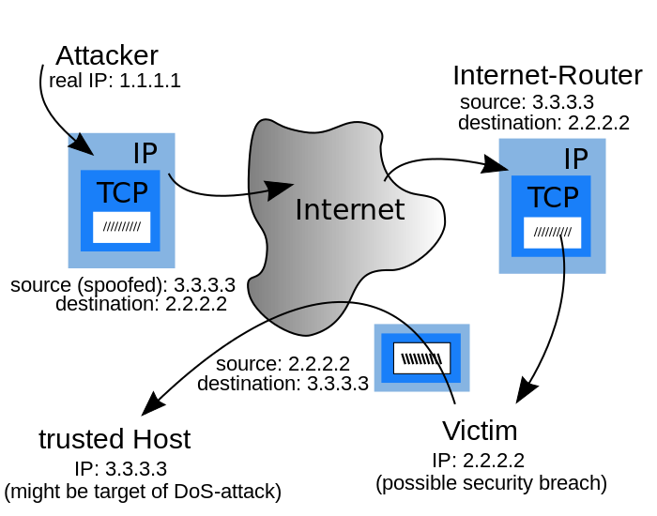
IP address spoofing
IP spoofing is the creation of Internet Protocol (IP) packets with a forged source IP address, with the purpose of concealing the identity of the sender or impersonating another computing system.

Slide 19
Caller ID spoofing
Public telephone networks often provide Caller ID information, which includes the caller's name and number, with each call. However, some technologies (especially in Voice over IP (VoIP) networks) allow callers to forge Caller ID information and present false names and numbers. Gateways between networks that allow such spoofing and other public networks then forward that false information. Since spoofed calls can originate from other countries

Slide 20

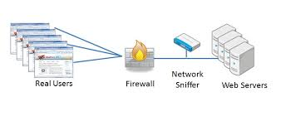
Sniffing
Sniffing is a passive attack on a ongoing conversation.
Packet sniffing is a form of wire-tap applied to computer networks instead of phone networks.

Slide 21
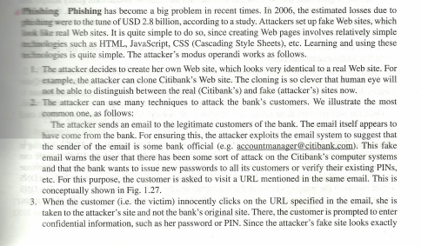
Phishing

Slide 22
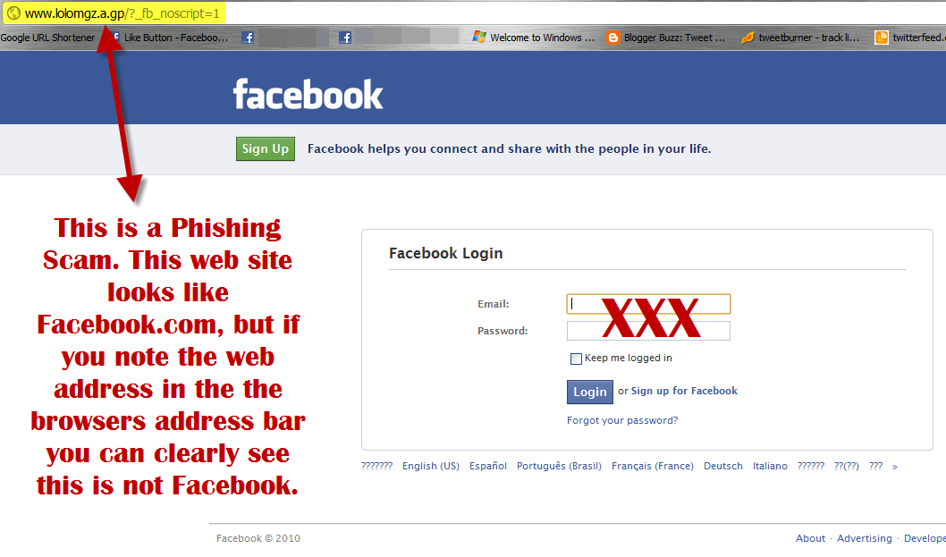

Slide 23
Denial-of-service attack
A denial of service (DoS) attack is a malicious attempt to make a server or a network resource unavailable to users, usually by temporarily interrupting or suspending the services of a host connected to the Internet.
symptoms of denial-of-service attacks to include:
Unusually slow network performance (opening files or accessing web sites)
Unavailability of a particular web site
Inability to access any web site
Dramatic increase in the number of spam emails received—(this type of DoS attack is considered an e-mail bomb)^{[4]}
Disconnection of a wireless or wired internet connection
Long term denial of access to the web or any internet services

Slide 24
